Slide 1
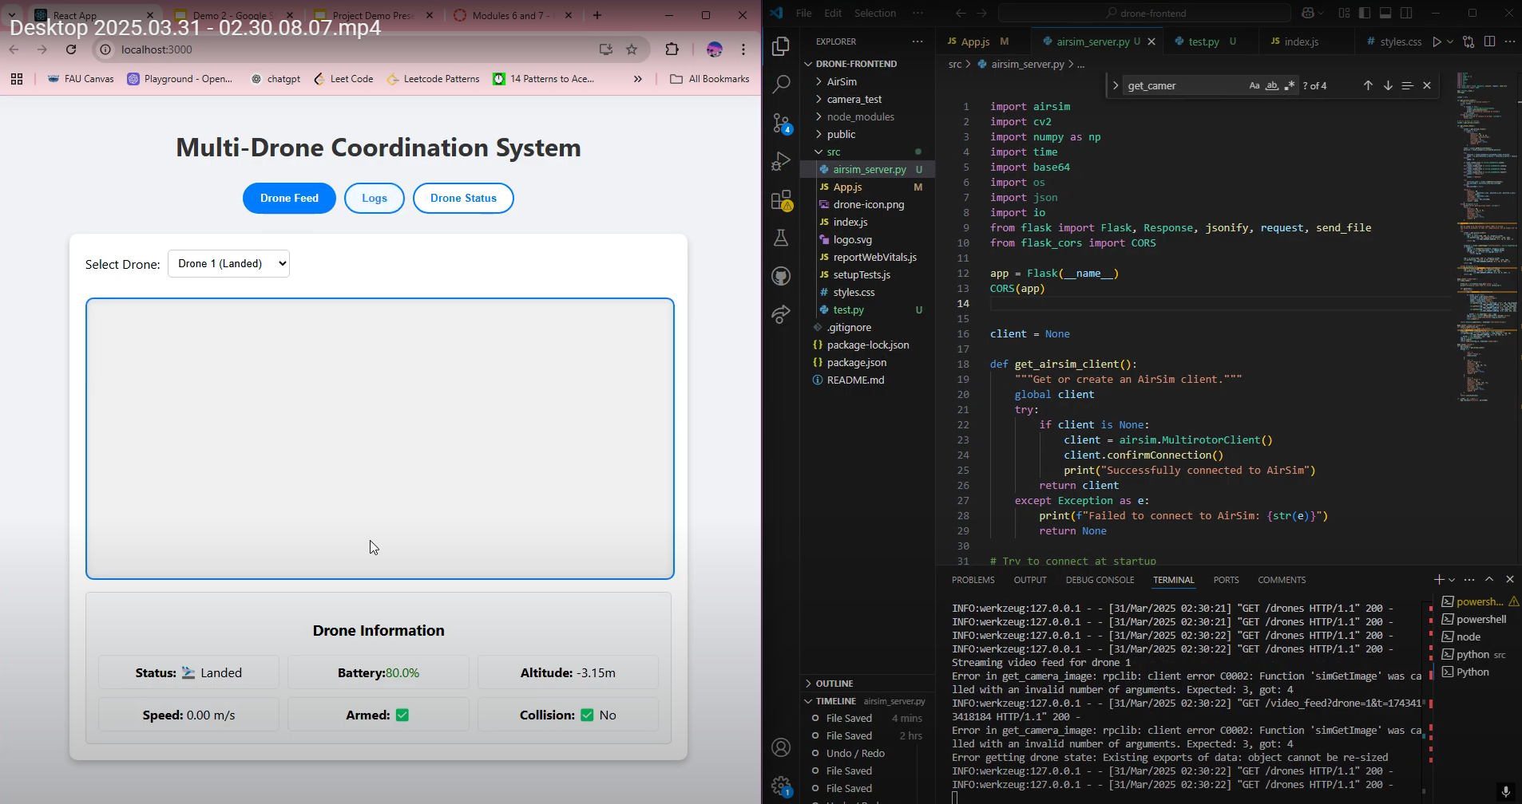
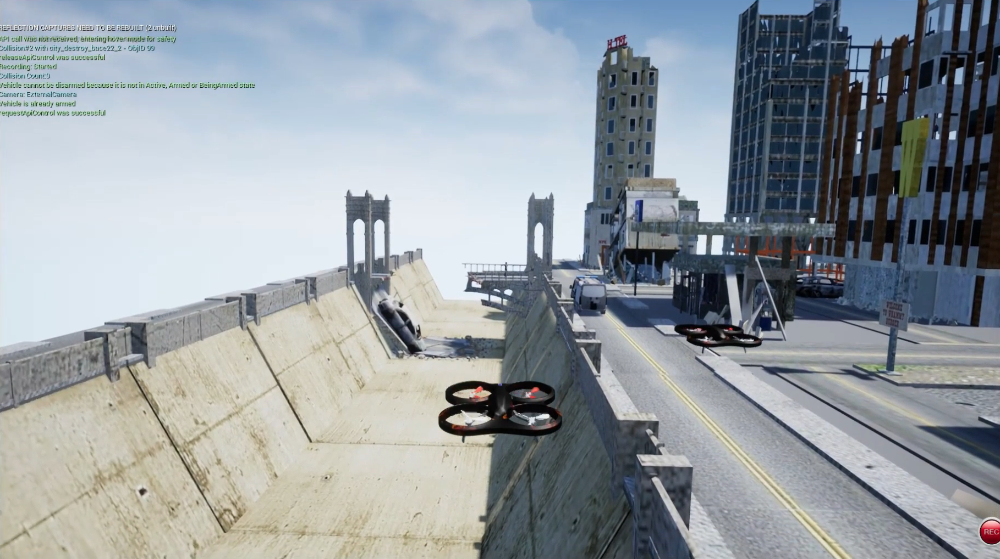
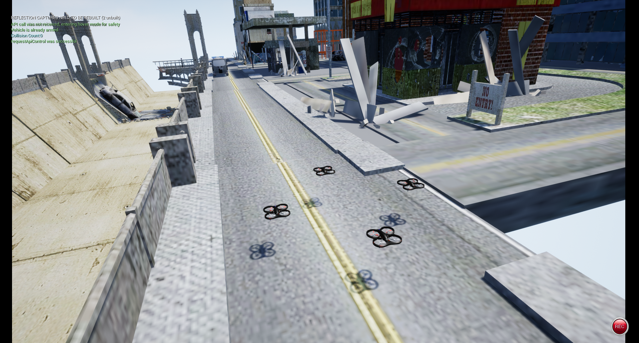
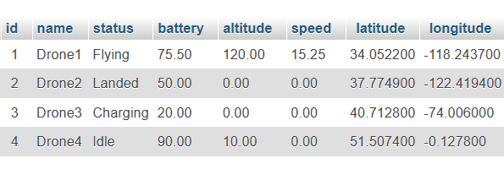
Multiple Drones Coordination
Team Members
Faculty Course Facilitator
Tutku Gizem Guder Matthew Paternoster Brenden Martins Matthew Wyatt Tarek Kayali
Dr. Waseem Asghar
EGN 4952C
Electrical Engineering & Computer Science
Project Advisor
#47
Sponsored by: Dr. Xiangnan Zhong
Dr. KwangSoo Yang
Dr. Xiangnan Zhong
Problem Statement
Disaster relief lacks timely detection and location of victims and hazard. Conventional methods are time-consuming and risky, so a better alternative is required. Multiple Drones Coordination System (MDCS) employs autonomous drones with target detection, control, communication, and simulation subsystems to support decision-making in real time. Effective multi-drone coordination, a working drone trustworthy data exchange, and user-friendly interfaces are needed for achieving such a feat. This project will create a real-time, scalable drone-based system to improve the efficiency, speed, and safety of disaster relief efforts.
Results
Its autonomous UAVs will ensure accurate target identification, minimizing false alarms while effectively scanning large areas. Reliable data transmission will provide real-time data to support better decision-making, and the system's scalability allows it to be customized to various disaster scenarios.
Conclusions & Impact
Utilizing autonomous drones with target detection, control, and communication subsystems, it improves decision-making, response time, and safety in emergency response. Scalability and efficiency are ensured through effective coordination, guaranteed data exchange, and user-friendly interfaces.
MDCS reduces human risk, response time is accelerated, and resource allocation is enhanced, thus saving more lives. Its uses cover various emergency scenarios, opening the door to smarter, technology-driven disaster management solutions.

